Slide 1
Chapter 3
Multiprocessor And Multicore Operating Systems

Slide 2
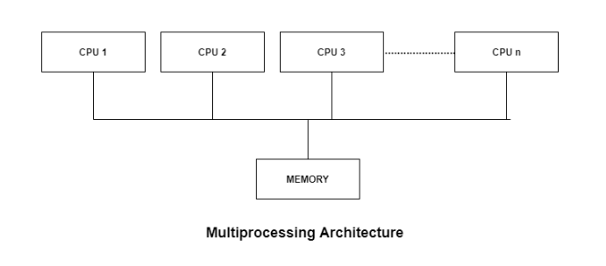
Introduction
Multiprocessor: A Multiprocessor is a computer system with two or more processors (CPUs) share full access to a common RAM.(sharing system bus, memory and I/O)
It allows parallel execution of different processors.
The main objective of using a multiprocessor is to boost the system’s execution speed, with other objectives being fault tolerance and application matching.

Slide 3
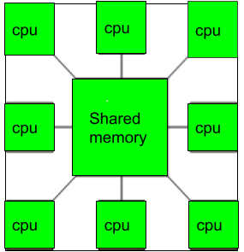
There are two types of multiprocessors, one is called shared memory multiprocessor and another is distributed memory multiprocessor.
In shared memory multiprocessors, all the CPUs shares the common memory but in a distributed memory multiprocessor, every CPU has its own private memory.

Slide 4
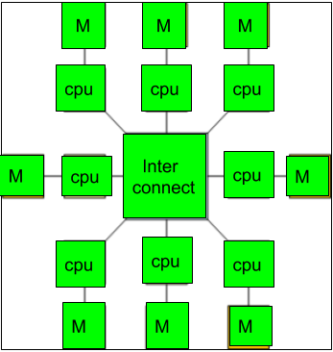
Multicomputer: A multicomputer system is a computer system with multiple processors that are connected together to solve a problem.
Each processor has its own memory and it is accessible by that particular processor and those processors can communicate with each other via an interconnection network.

Slide 5
Advantages of Multiprocessor Systems
There are multiple advantages to multiprocessor systems.
More reliable Systems
In a multiprocessor system, even if one processor fails, the system will not halt.
Enhanced Throughput
If multiple processors are working in tandem, then the throughput of the system increases
More Economic Systems
Multiprocessor systems are cheaper than single processor systems in the long run because they share the data storage, peripheral devices, power supplies etc.

Slide 6
Disadvantages of Multiprocessor Systems
There are some disadvantages as well to multiprocessor systems.
Increased Expense
Complicated Operating System Required
Large Main Memory Required

Slide 7
Multicore System : A processor that has more than one core is called Multicore Processor while one with single core is called Unicore Processor or Uniprocessor.
Core-separate processing units
Nowadays, most of systems have four cores (Quad-core) or eight cores (Octa-core).
These cores can individually read and execute program instructions, giving feel like computer system has several processors but in reality, they are cores and not processors.
In a multicore system, a single processor can run several instructions at the same time and this, in turn, increases the overall speed of the program execution in the system
These multicore processors are widely used in many domains like general-purpose, embedded, network, and graphics(GPU).

Slide 8
Advantages of multicore systems:
Since multiple CPU cores are placed on the same die, so in this case, cache coherency will be higher.
It allows higher performance at lower energy because the cores are very energy efficient.
Disadvantages of multicore systems:
If you are using a dual-core system, then its speed should be double than the single-core but in reality, you will get 70-80% more speed only.
Not every Operating System supports multi-core.

Slide 9
Types of Multiprocessors
There are mainly two types of multiprocessors i.e. symmetric and asymmetric multiprocessors.
Symmetric Multiprocessors
In these types of systems, each processor contains a similar copy of the operating system and they all communicate with each other.
All the processors are in a peer to peer relationship i.e. no master - slave relationship exists between them.
An example of the symmetric multiprocessing system is the Encore version of Unix for the Multimax Computer.

Slide 10
Asymmetric Multiprocessors
In asymmetric systems, each processor is given a predefined task.
There is a master processor that gives instruction to all the other processors.
Asymmetric multiprocessor system contains a master slave relationship.
Asymmetric multiprocessor was the only type of multiprocessor available before symmetric multiprocessors were created. Now also, this is the cheaper option.

Slide 11
Multicore System vs Multiprocessor System
We have seen what a multicore system and a multiprocessor system is. These are two different things.
The only common thing that they share is both want to increase the processing speed of the system by executing more than one processes at a time.
Some of the differences between these two are:
In a multicore system, we have only one CPU and multiple cores are present in that CPU. While in a multiprocessor system, we have more than one CPU.
Since the multicore system contains only one CPU, so the cost of the multicore system is lower as compared to the multiprocessor system.
If you want to run a single program then the multicore system will be faster. But if you are running multiple programs then the multiprocessor system will be faster.

Slide 12
BASIC MULTICORE CONCEPTS
MEMORY Sharing Styles
Multiprocessors can be categorized into three shared-memory model which are:
Uniform Memory Access(UMA)
Non-Uniform Memory Access(NUMA)
No Remote Memory Access(NORMA)

Slide 13
Uniform Memory Access(UMA)
In this model, all the processors share the physical memory uniformly.
All the processors have equal access time to all the memory words.
Each processor may have a private cache memory.
Same rule is followed for peripheral devices.
When all the processors have equal access to all the peripheral devices, the system is called a symmetric multiprocessor. When only one or a few processors can access the peripheral devices, the system is called an asymmetric multiprocessor.

Slide 14
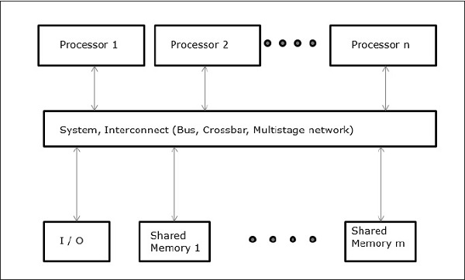

Slide 15
Non-uniform Memory Access (NUMA)
In NUMA multiprocessor model, the access time varies with the location of the memory word.
Here, the shared memory is physically distributed among all the processors, called local memories.
The collection of all local memories forms a global address space which can be accessed by all the processors.
In NUMA, where different memory controller is used.
Non-uniform Memory Access is faster than uniform Memory Access.
Non-uniform Memory Access is applicable for real-time applications and time-critical applications.

Slide 16
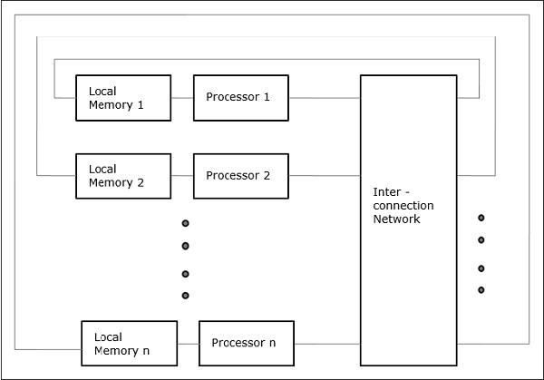

Slide 17
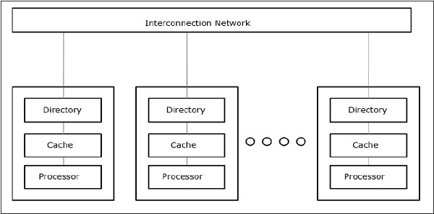
Cache Only Memory Architecture (COMA)
The COMA model is a special case of the NUMA model. Here, all the distributed main memories are converted to cache memories.
Distributed - Memory Multicomputers −
A distributed memory multicomputer system consists of multiple computers, known as nodes, inter-connected by message passing network.

Slide 18
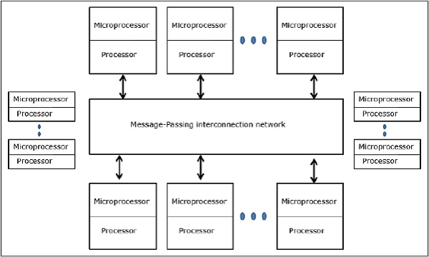
Each node acts as an autonomous computer having a processor, a local memory and sometimes I/O devices.
In this case, all local memories are private and are accessible only to the local processors.
This is why, the traditional machines are called no-remote-memory-access (NORMA) machines.

Slide 19
Cache Coherence
In a multiprocessor system, data inconsistency may occur among adjacent levels or within the same level of the memory hierarchy.
In a shared memory multiprocessor with a separate cache memory for each processor, it is possible to have many copies of any one instruction operand: one copy in the main memory and one in each cache memory. When one copy of an operand is changed, the other copies of the operand must be changed also.
Cache coherence is the discipline that ensures that changes in the values of shared operands are propagated throughout the system in a timely fashion.

Slide 20
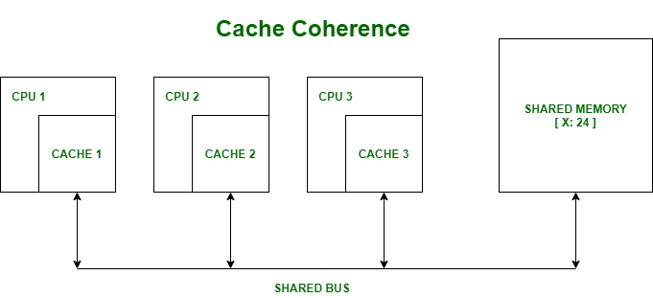
Example : Cache and the main memory may have inconsistent copies of the same object.

Slide 21
Suppose there are three processors, each having cache. Suppose the following scenario:-
Processor 1 read X : obtains 24 from the memory and caches it.
Processor 2 read X : obtains 24 from memory and caches it.
Again, processor 1 writes as X : 64, Its locally cached copy is updated. Now, processor 3 reads X, what value should it get?
Memory and processor 2 thinks it is 24 and processor 1 thinks it is 64.
As multiple processors operate in parallel, and independently multiple caches may possess different copies of the same memory block, this creates a cache coherence problem.

Slide 22
Coherency mechanisms : There are three types of coherence :
Directory-based – In a directory-based system, the data being shared is placed in a common directory that maintains the coherence between caches. The directory acts as a filter through which the processor must ask permission to load an entry from the primary memory to its cache. When an entry is changed, the directory either updates or invalidates the other caches with that entry.
Snooping – First introduced in 1983, It is called a write invalidate prsnooping is a process where the individual caches monitor address lines for accesses to memory locations that they have cached.otocol. When a write operation is observed to a location that a cache has a copy of and the cache controller invalidates its own copy of the snooped memory location.
Snarfing – It is a mechanism where a cache controller watches both address and data in an attempt to update its own copy of a memory location when a second master modifies a location in main memory. When a write operation is observed to a location that a cache has a copy of the cache controller updates its own copy of the snarfed memory location with the new data.

Slide 23

Interprocess communication
A process can be of two types:
Independent process.
Co-operating process.
An independent process is not affected by the execution of other processes while a co-operating process can be affected by other executing processes.
It is the mechanism provided by the operating system that allows processes to communicate with each other. This communication could involve a process letting another process know that some event has occurred or the transferring of data from one process to another.

Slide 24
Synchronization in Interprocess Communication
Synchronization is a necessary part of interprocess communication. It is either provided by the interprocess control mechanism or handled by the communicating processes.
Some of the methods to provide synchronization are as follows −
Semaphore
A semaphore is a variable that controls the access to a common resource by multiple processes. Types-are binary semaphores and counting semaphores.
Mutual Exclusion
Mutual exclusion requires that only one process thread can enter the critical section at a time. This is useful for synchronization and also prevents race conditions.
Barrier
A barrier does not allow individual processes to proceed until all the processes reach it. Many parallel languages and collective routines impose barriers.
Spinlock
This is a type of lock. The processes trying to acquire this lock wait in a loop while checking if the lock is available or not. This is known as busy waiting because the process is not doing any useful operation even though it is active.

Slide 25
Approaches to Interprocess Communication
The different approaches to implement interprocess communication are given as follows −
Pipe
A pipe is a data channel that is unidirectional. Two pipes can be used to create a two-way data channel between two processes. This uses standard input and output methods. Pipes are used in all POSIX systems as well as Windows operating systems.
Socket
The socket is the endpoint for sending or receiving data in a network. This is true for data sent between processes on the same computer or data sent between different computers on the same network. Most of the operating systems use sockets for interprocess communication.
File
A file is a data record that may be stored on a disk or acquired on demand by a file server. Multiple processes can access a file as required. All operating systems use files for data storage.

Slide 26
Signal
Signals are useful in interprocess communication in a limited way. They are system messages that are sent from one process to another. Normally, signals are not used to transfer data but are used for remote commands between processes.
Shared Memory
Shared memory is the memory that can be simultaneously accessed by multiple processes. This is done so that the processes can communicate with each other. All POSIX systems, as well as Windows operating systems use shared memory.
Message Queue
Multiple processes can read and write data to the message queue without being connected to each other. Messages are stored in the queue until their recipient retrieves them. Message queues are quite useful for interprocess communication and are used by most operating systems.

Slide 27
Processes can communicate with each other through both:
Shared Memory
Message passing
Communication between processes using shared memory requires processes to share some variable and it completely depends on how programmer will implement it.
Processes can use shared memory for extracting information as a record from another process as well as for delivering any specific information to other processes.

Slide 28
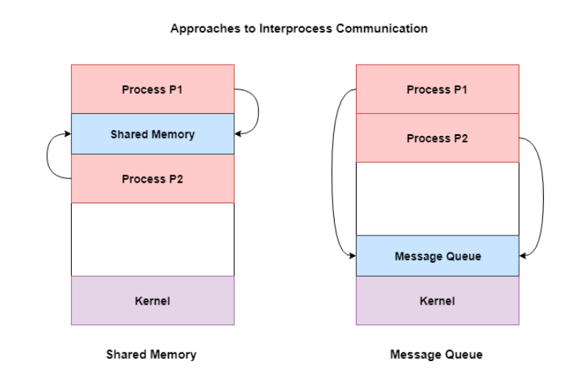
A diagram that demonstrates message queue and shared memory methods of interprocess communication is as follows −

Slide 29
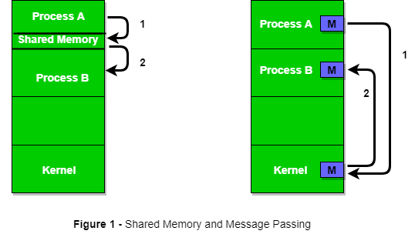
Let’s discuss an example of communication between processes using shared memory method.

Slide 30
ii) Messaging Passing Method
Now, We will start our discussion of the communication between processes via message passing. In this method, processes communicate with each other without using any kind of shared memory. If two processes p1 and p2 want to communicate with each other, they proceed as follows:
Establish a communication link (if a link already exists, no need to establish it again.)
Start exchanging messages using basic primitives. We need at least two primitives: – send(message, destinaion) or send(message) – receive(message, host) or receive(message)

Slide 31
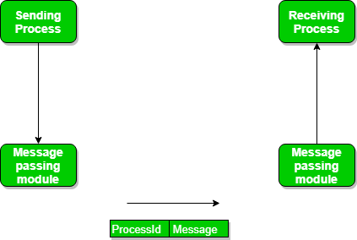

Slide 32
Message Passing through Exchanging the Messages.
Synchronous and Asynchronous Message Passing: A process that is blocked is one that is waiting for some event, such as a resource becoming available or the completion of an I/O operation. IPC is possible between the processes on same computer as well as on the processes running on different.
In Direct message passing, The process which want to communicate must explicitly name the recipient or sender of communication.

Slide 33
Mobile Operating System
A mobile operating system is an operating system that helps to run other application software on mobile devices. It is the same kind of software as the famous computer operating systems like Linux and Windows, but now they are light and simple to some extent.
The operating systems found on smartphones include Symbian OS, iPhone OS, RIM's BlackBerry, Windows Mobile, Palm WebOS, Android, and Maemo. Android, WebOS, and Maemo are all derived from Linux. The iPhone OS originated from BSD and NeXTSTEP, which are related to Unix.
It combines the beauty of computer and hand use devices. It typically contains a cellular built-in modem and SIM tray for telephony and internet connections. If you buy a mobile, the manufacturer company chooses the OS for that specific device.

Slide 34
Popular platforms of the Mobile OS
1. Android OS: The Android operating system is the most popular operating system today. It is a mobile OS based on the Linux Kernel and open-source software. The android operating system was developed by Google. The first Android device was launched in 2008.
2. Bada (Samsung Electronics): Bada is a Samsung mobile operating system that was launched in 2010. The Samsung wave was the first mobile to use the bada operating system. The bada operating system offers many mobile features, such as 3-D graphics, application installation, and multipoint-touch.
3. BlackBerry OS: The BlackBerry operating system is a mobile operating system developed by Research In Motion (RIM). This operating system was designed specifically for BlackBerry handheld devices. This operating system is beneficial for the corporate users because it provides synchronization with Microsoft Exchange, Novell GroupWise email, Lotus Domino, and other business software when used with the BlackBerry Enterprise Server.
4. iPhone OS / iOS: The iOS was developed by the Apple inc for the use on its device. The iOS operating system is the most popular operating system today. It is a very secure operating system. The iOS operating system is not available for any other mobiles.

Slide 35
5. Symbian OS: Symbian operating system is a mobile operating system that provides a high-level of integration with communication. The Symbian operating system is based on the java language. It combines middleware of wireless communications and personal information management (PIM) functionality. The Symbian operating system was developed by Symbian Ltd in 1998 for the use of mobile phones. Nokia was the first company to release Symbian OS on its mobile phone at that time.
6. Windows Mobile OS: The window mobile OS is a mobile operating system that was developed by Microsoft. It was designed for the pocket PCs and smart mobiles.
7. Harmony OS: The harmony operating system is the latest mobile operating system that was developed by Huawei for the use of its devices. It is designed primarily for IoT devices.
8. Palm OS: The palm operating system is a mobile operating system that was developed by Palm Ltd for use on personal digital assistants (PADs). It was introduced in 1996. Palm OS is also known as the Garnet OS.
9. WebOS (Palm/HP): The WebOS is a mobile operating system that was developed by Palm. It based on the Linux Kernel. The HP uses this operating system in its mobile and touchpads.

Slide 36
What is Android?
Android is an open source and Linux-based Operating System for mobile devices such as smartphones and tablet computers. Android was developed by the Open Handset Alliance, led by Google, and other companies.
Android offers a unified approach to application development for mobile devices which means developers need only develop for Android, and their applications should be able to run on different devices powered by Android.
The first beta version of the Android Software Development Kit (SDK) was released by Google in 2007 where as the first commercial version, Android 1.0, was released in September 2008.
On June 27, 2012, at the Google I/O conference, Google announced the next Android version, 4.1 Jelly Bean. Jelly Bean is an incremental update, with the primary aim of improving the user interface, both in terms of functionality and performance.
The source code for Android is available under free and open source software licenses. Google publishes most of the code under the Apache License version 2.0 and the rest, Linux kernel changes, under the GNU General Public License version 2.

Slide 37
